Slide 1
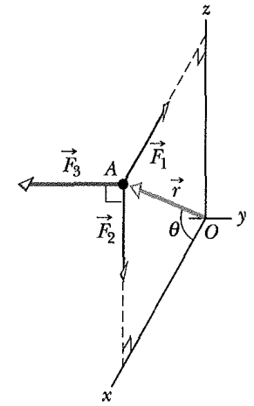
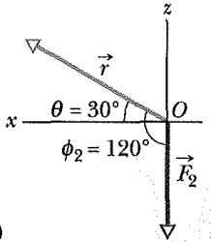
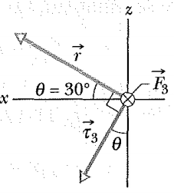
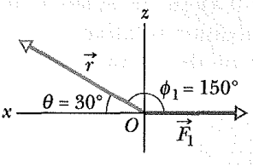
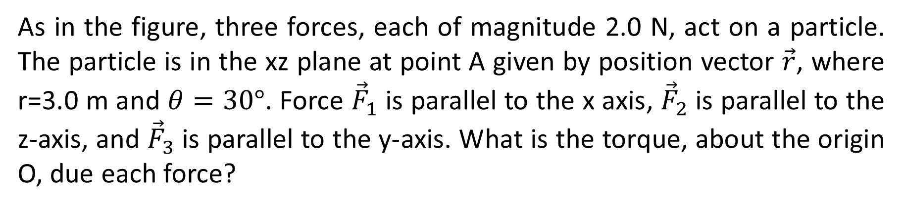
As in the figure, three forces, each of magnitude 2.0 N, act on a particle. The particle is in the xz plane at point A given by position vector $\vec{r}$, where r=3.0 m and $θ=30°$. Force ${\vec{F}}_{1}$ is parallel to the x axis, ${\vec{F}}_{2}$ is parallel to the z-axis, and ${\vec{F}}_{3}$ is parallel to the y-axis. What is the torque, about the origin O, due each force?

Slide 2
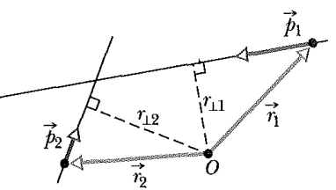
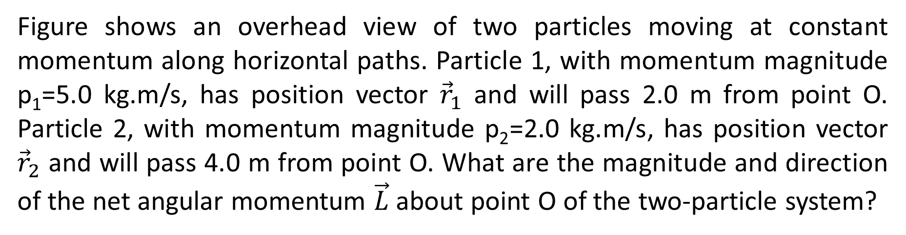
Figure shows an overhead view of two particles moving at constant momentum along horizontal paths. Particle 1, with momentum magnitude p₁=5.0 kg.m/s, has position vector ${\vec{r}}_{1}$ and will pass 2.0 m from point O. Particle 2, with momentum magnitude p₂=2.0 kg.m/s, has position vector ${\vec{r}}_{2}$ and will pass 4.0 m from point O. What are the magnitude and direction of the net angular momentum $\vec{L}$ about point O of the two-particle system?

Slide 3
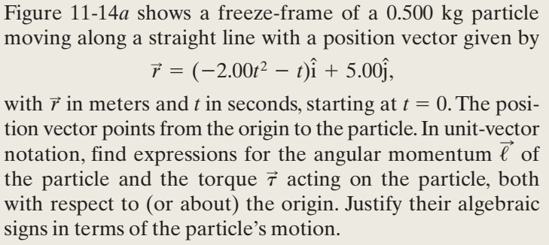
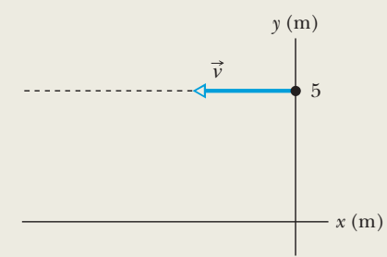

Slide 4
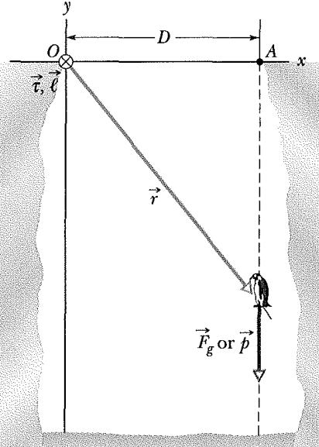
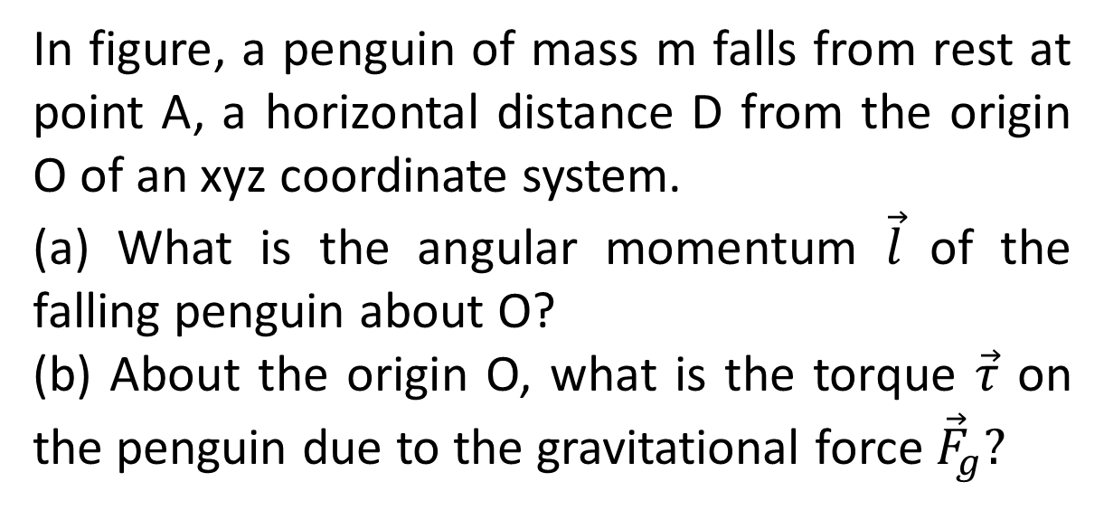
In figure, a penguin of mass m falls from rest at point A, a horizontal distance D from the origin O of an xyz coordinate system.
(a) What is the angular momentum $\vec{l}$ of the falling penguin about O?
(b) About the origin O, what is the torque $\vec{τ}$ on the penguin due to the gravitational force ${\vec{F}}_{g}?$

Slide 5
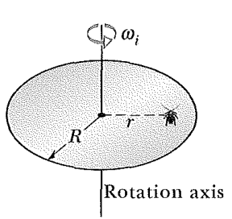
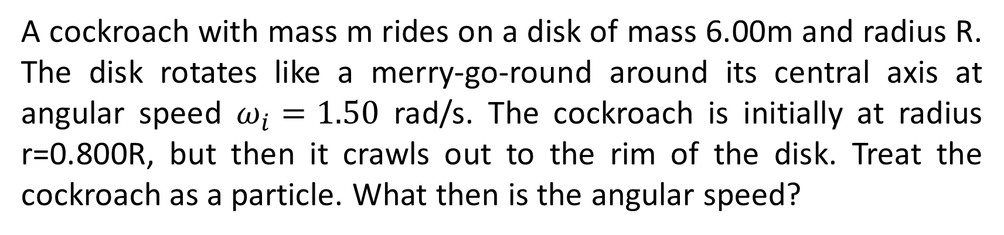
A cockroach with mass m rides on a disk of mass 6.00m and radius R. The disk rotates like a merry-go-round around its central axis at angular speed $ω_{i}=1.50$ rad/s. The cockroach is initially at radius r=0.800R, but then it crawls out to the rim of the disk. Treat the cockroach as a particle. What then is the angular speed?

Slide 6
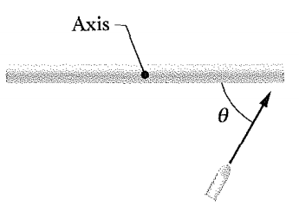
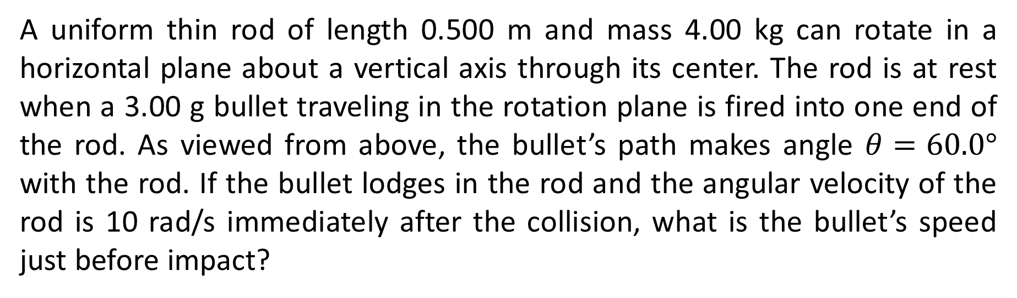
A uniform thin rod of length 0.500 m and mass 4.00 kg can rotate in a horizontal plane about a vertical axis through its center. The rod is at rest when a 3.00 g bullet traveling in the rotation plane is fired into one end of the rod. As viewed from above, the bullet’s path makes angle $θ=60.0°$ with the rod. If the bullet lodges in the rod and the angular velocity of the rod is 10 rad/s immediately after the collision, what is the bullet’s speed just before impact?

